Slide 1


Test Automation Using Selenium
Fair Hike Academy
That’s the way the cookie crumbles!
Session 10: Selenium WebDriver
Mentor : Naresh Vulli, CSTE, PAHM.
fairhike@gmail.com www.fairhike.blogspot.com | www.facebook.com/fairhike

Slide 2
Today’s Topics
Recap
Selenium WebDriver
WebDriver Java Packages
Selenium with Eclipse
GoogleSearch Program
Executing WebDriver Program
Takeaways or Exercise

Slide 3
Selenium WebDriver
WebDriver is a collection of libraries for testing web applications across different browsers using different programming languages
With WebDriver we can design powerful tests. Supports
Java
C#
Ruby
Python

Slide 4
WebDriver Java Packages
http://www.seleniumhq.org/download/
Java latest version – 2.53.0
Selenium can be extended through the use of plugins. There are a number of plugins created and maintained by third parties

Slide 5
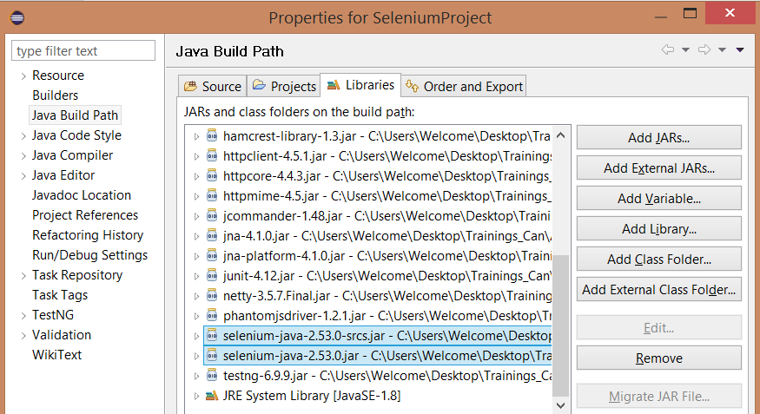
Selenium with Eclipse

Slide 6
Google Search Program
package SeleniumPrograms;
import java.util.concurrent.TimeUnit;
import org.openqa.selenium.By;
import org.openqa.selenium.WebDriver;
import org.openqa.selenium.firefox.FirefoxDriver;
public class GoogleSearch
{
public static void main(String[] args)
{
WebDriver driver = new FirefoxDriver();
driver.manage().timeouts().implicitlyWait(60, TimeUnit.SECONDS);
driver.get("http://www.google.com");
driver.findElement(By.name("q")).sendKeys("selenium");;
driver.findElement(By.name("btnG")).click();
System.out.println(driver.findElement(By.id("resultStats")).getText());
System.out.println(driver.getTitle());
driver.quit();
}
}

Slide 7
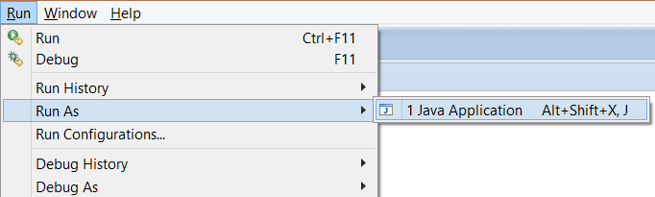
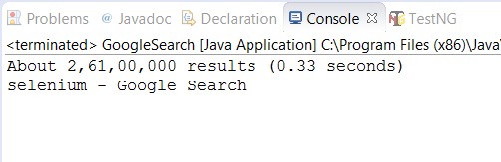
Executing WebDriver Program

Slide 8
Takeaway or Exercise
Add Selenium libraries to your Java Project
Execute Google search program from Eclipse

Slide 9
Q & A

Slide 10
Thank You ☺

